Slide 1
Chess Game
Sajjad Hossain Sadi
Roll - 1907074

Slide 2
App Features
Sign up
Log in
Multiple player
Game timer
User Information
Player performance
Database
Leader Board
THE GAME ITSELF

Slide 3
TABLE OF CONTENTS
01
02
03
04
Flow chart
Use of Data Base
Work Flow
Applications

Slide 4
01
Flow chart

Slide 5
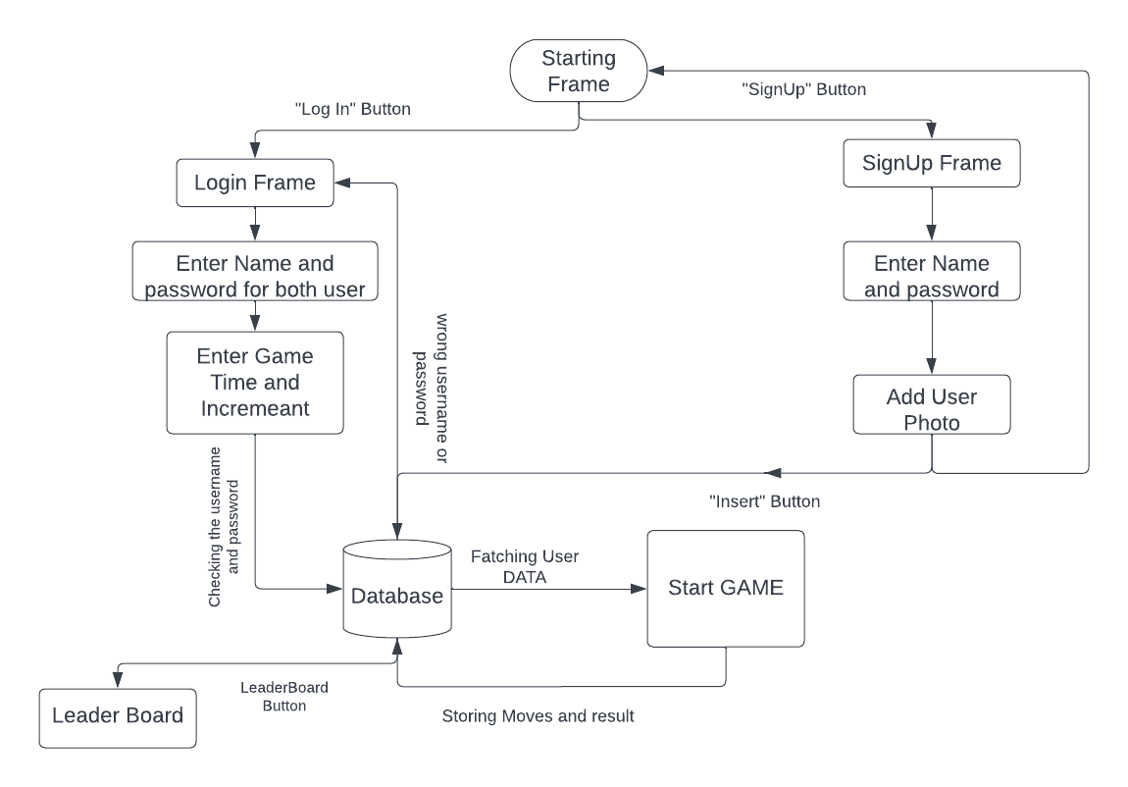
Flow Chart

Slide 6
02
Use of Data Base

Slide 7
Use of Data Base
Things that can be stored are:-
user name and password
user information
User performance
User photo
Game information
Moves and results

Slide 8
03
Project Screenshots

Slide 9
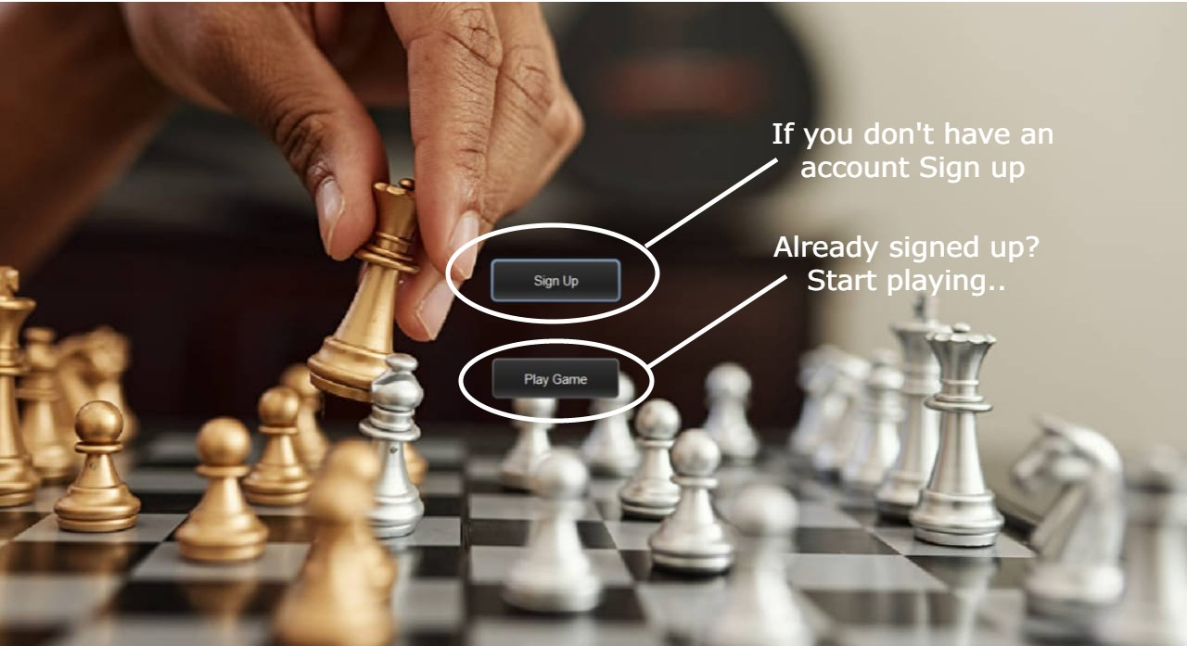
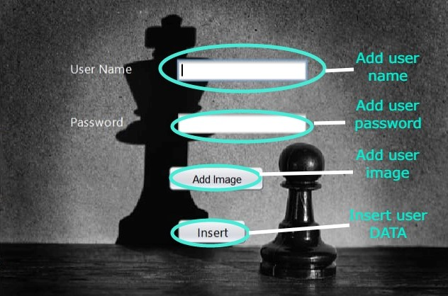
Project Screenshots

Slide 10
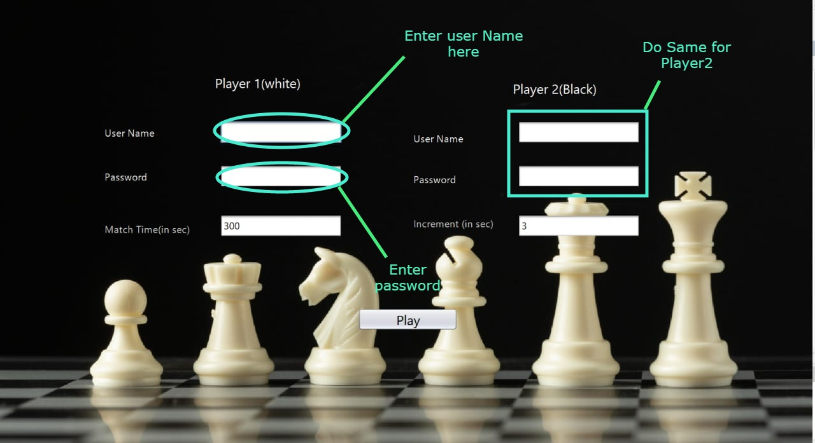
Project Screenshots

Slide 11
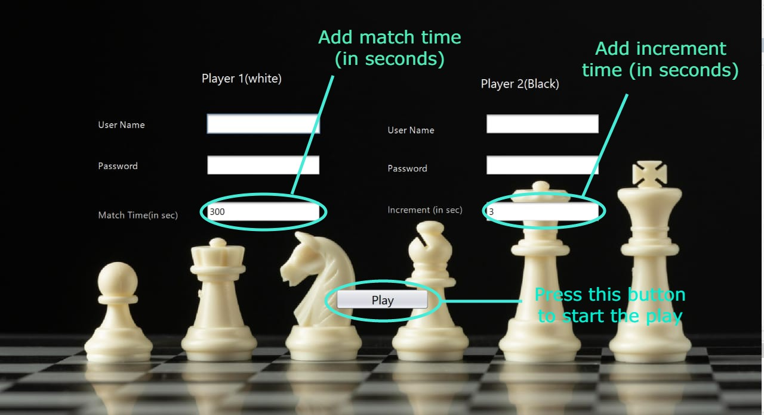
Project Screenshots

Slide 12
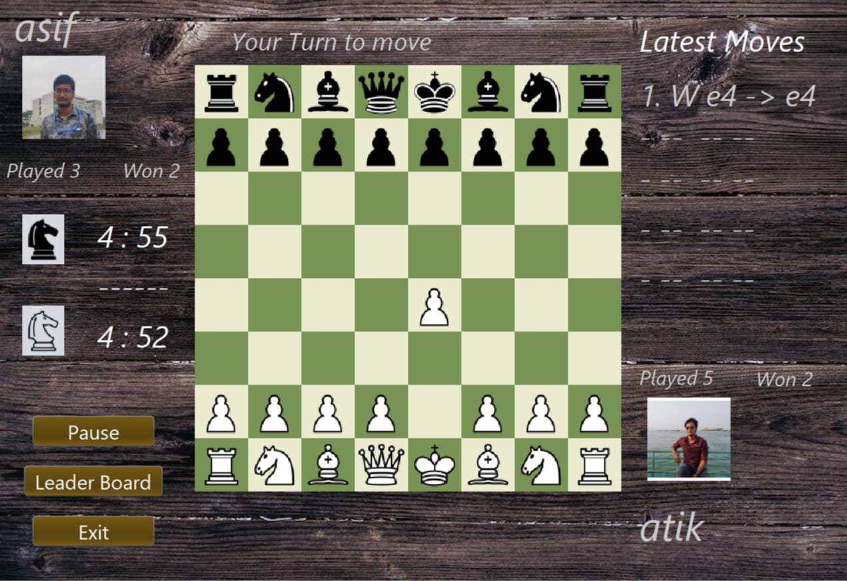
Project Screenshots (App interphase)

Slide 13
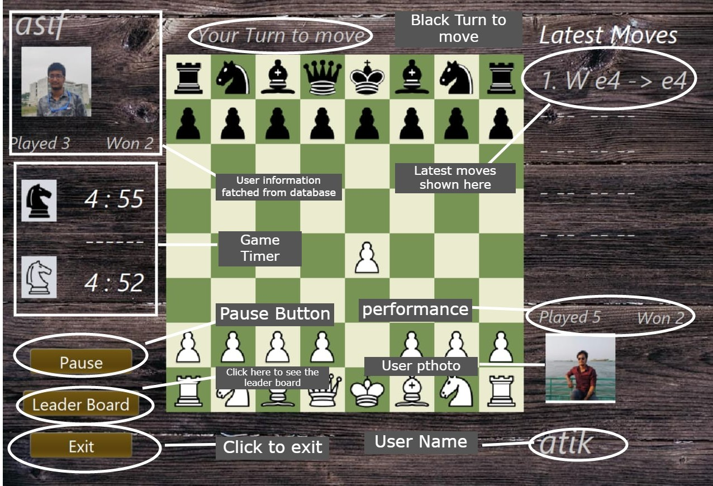
Project Screenshots

Slide 14
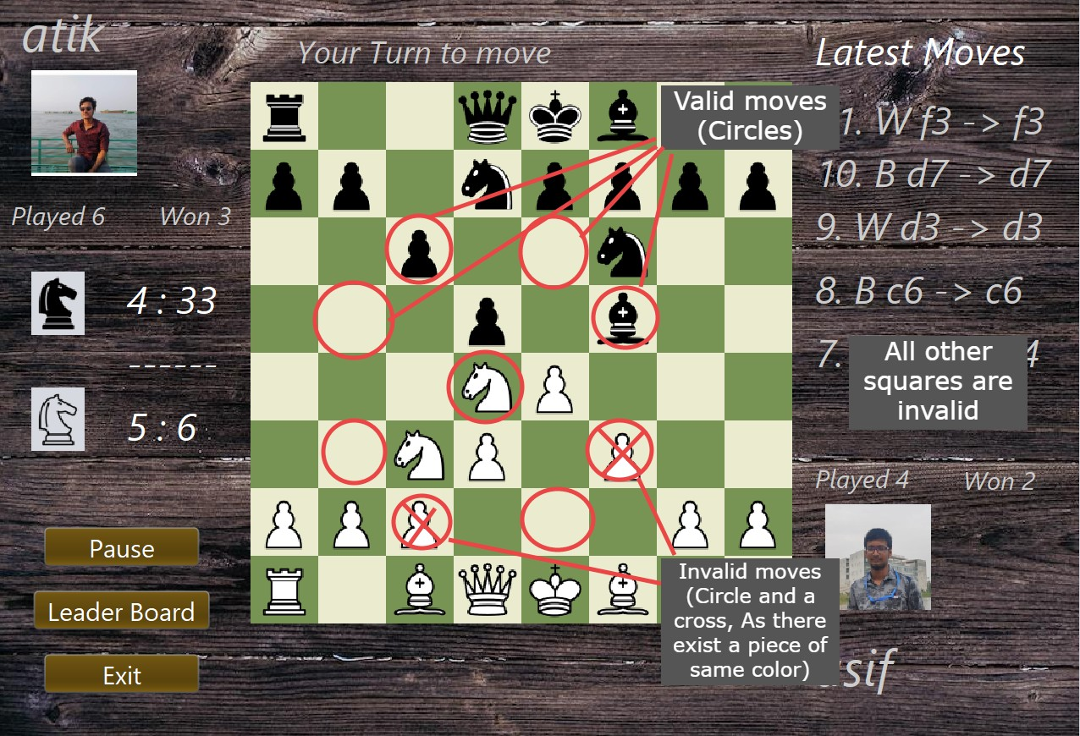
Project Screenshots

Slide 15
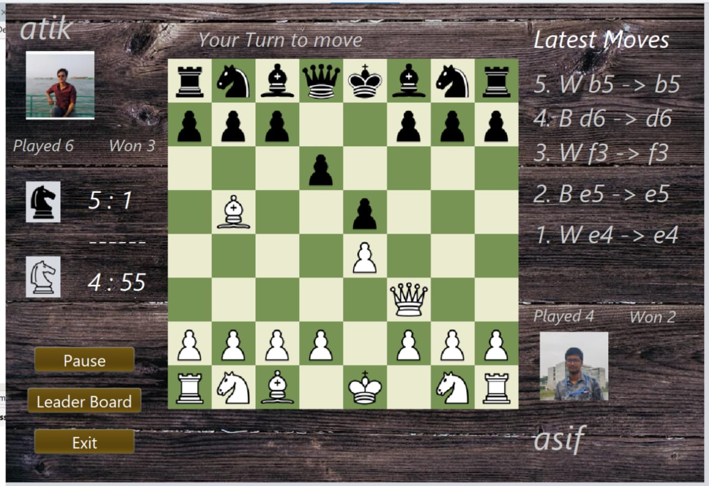
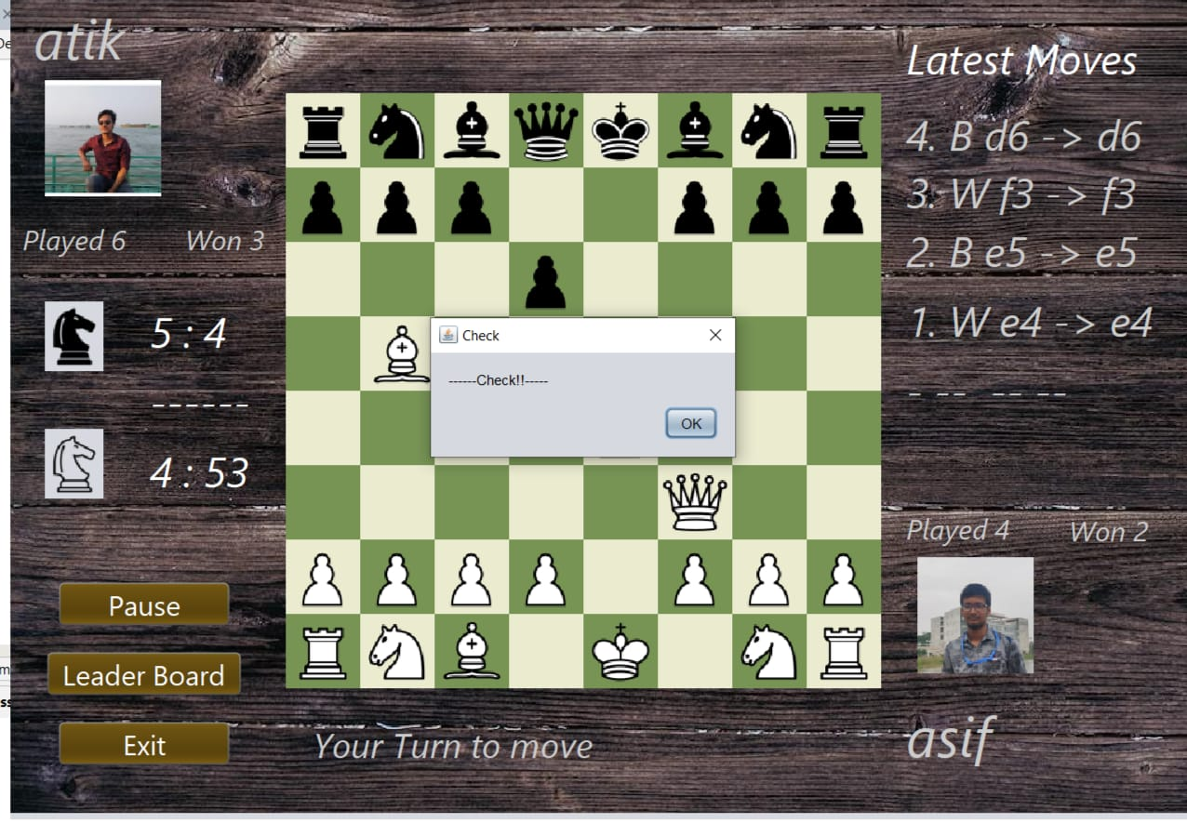
Project Screenshots

Slide 16
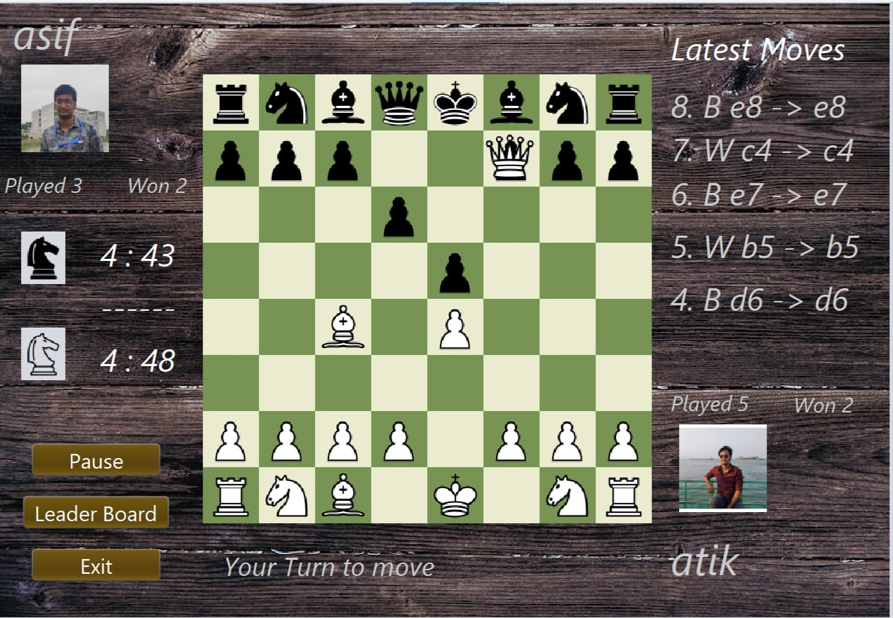
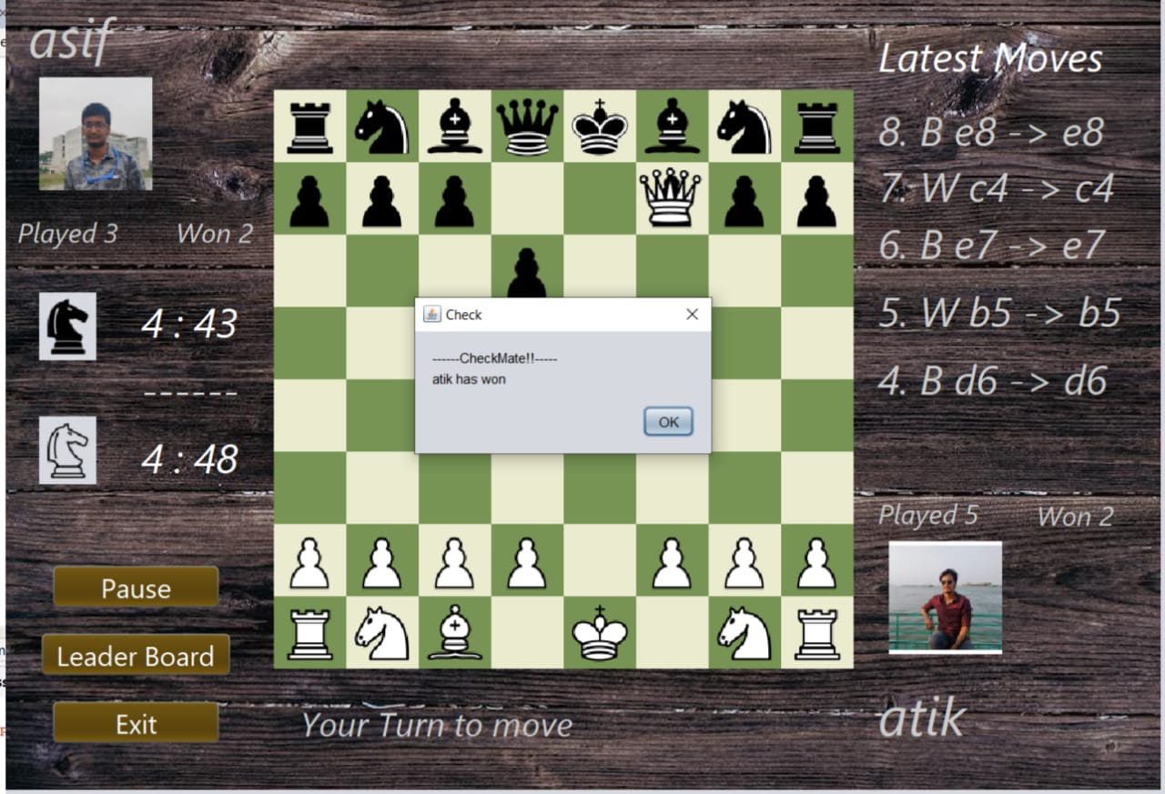
Project Screenshots

Slide 17
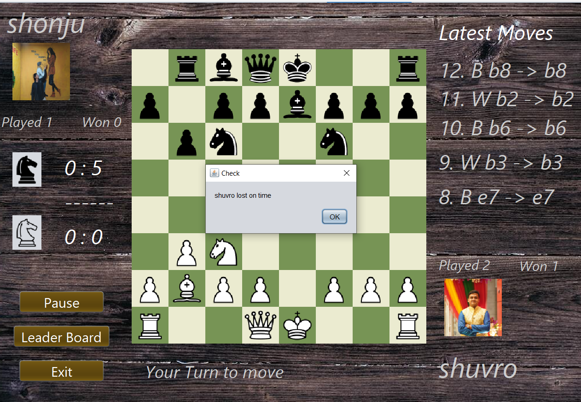
Project Screenshots

Slide 18
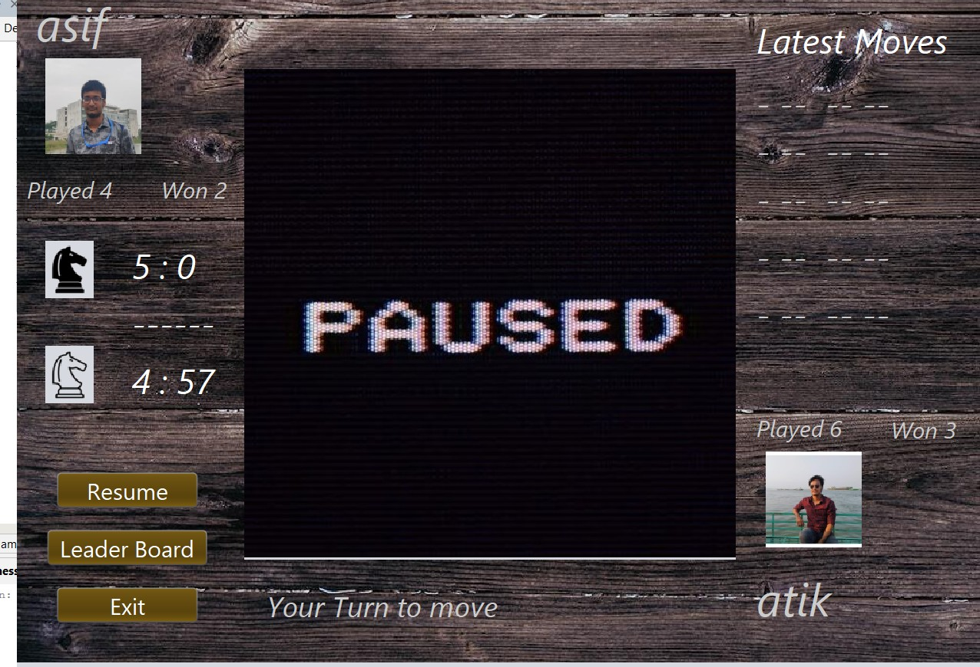
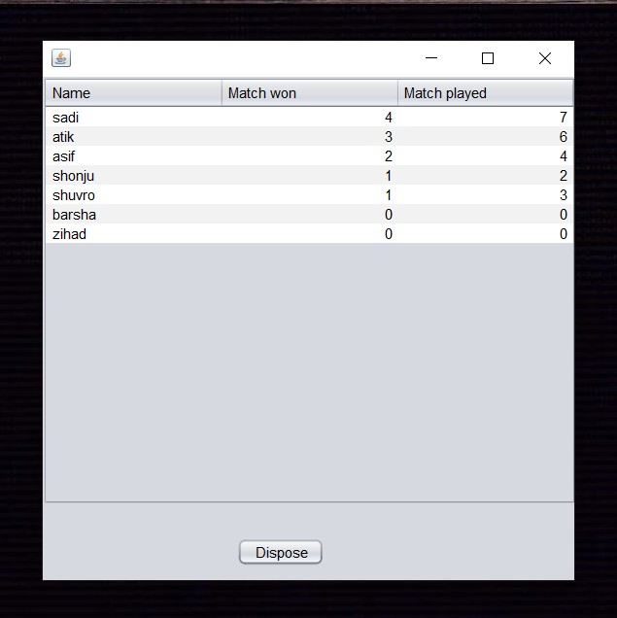
Project Screenshots
Fig: Paused Button clicked
Fig: Leader Board

Slide 19
04
Applications

Slide 20
Applications
Development of higher-order thinking skills
Improve problem solving skills
Multiplayer Game
Built-in timer
User Performance analysis

Slide 21
The logical part
The most interesting part of this project.

Slide 22
2,000+
Lines of hand written code

Slide 23
THANKS
DO YOU HAVE ANY QUESTIONS?

